Slide 1
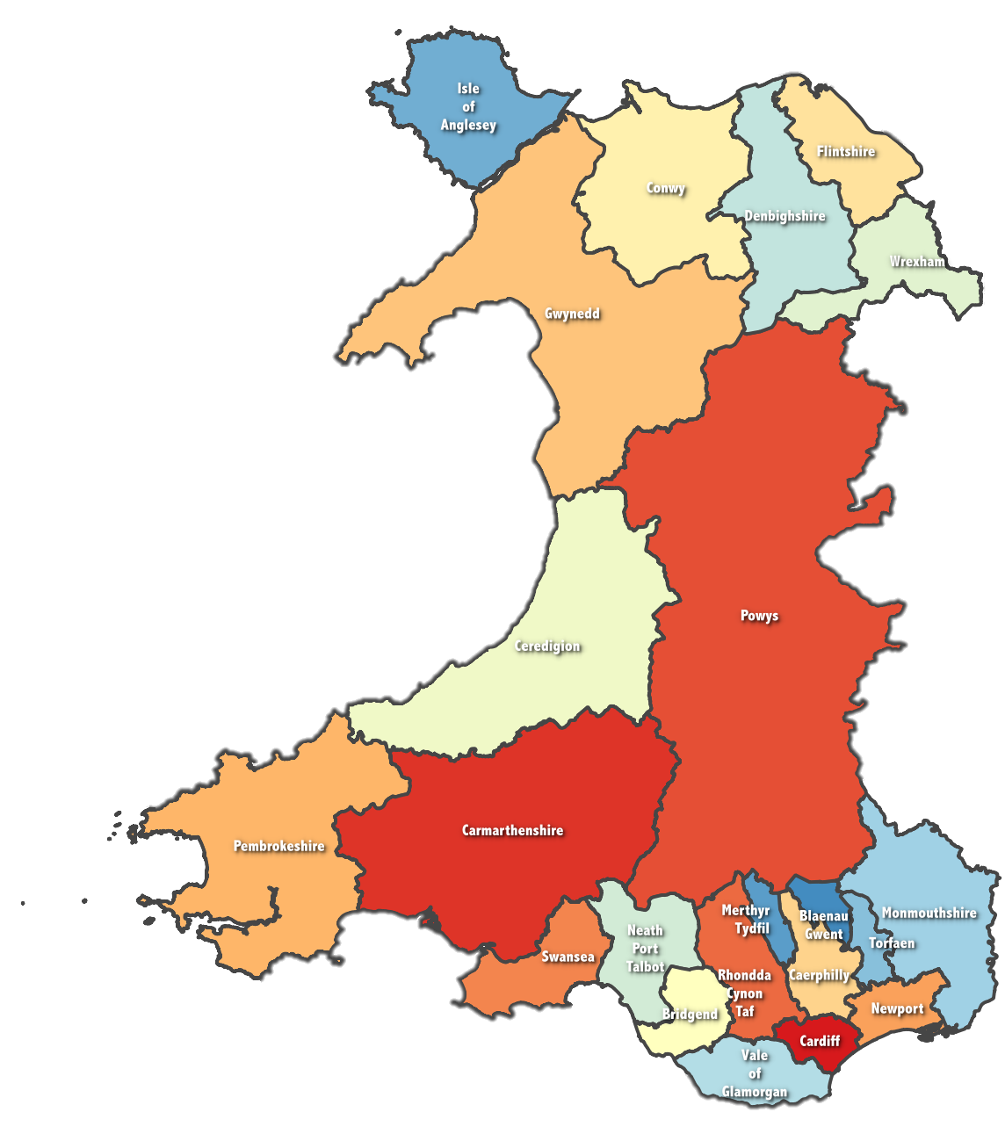
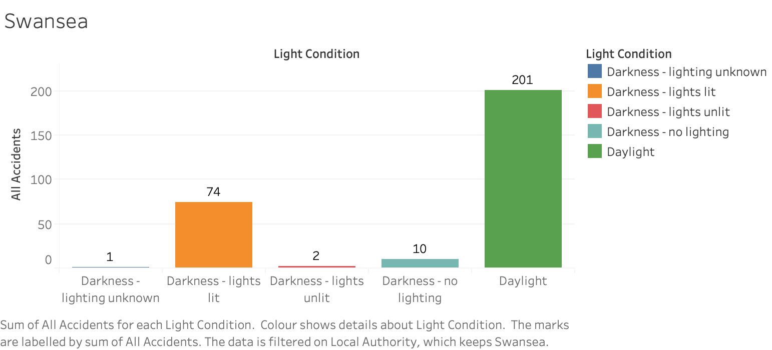
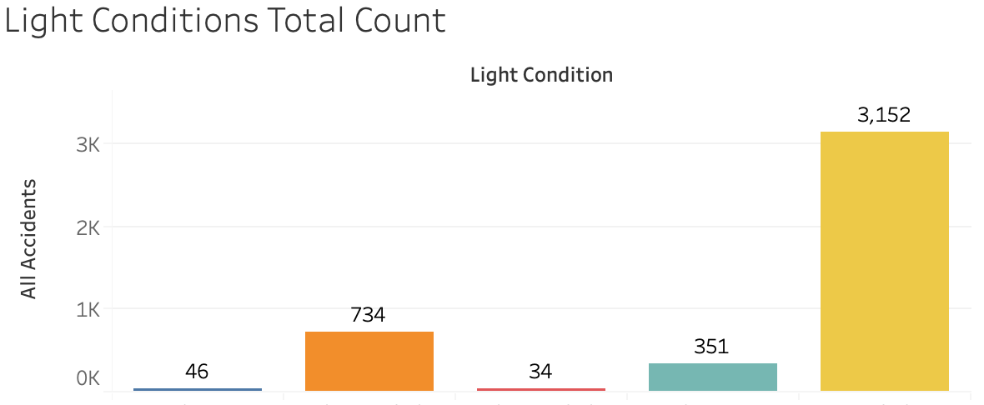
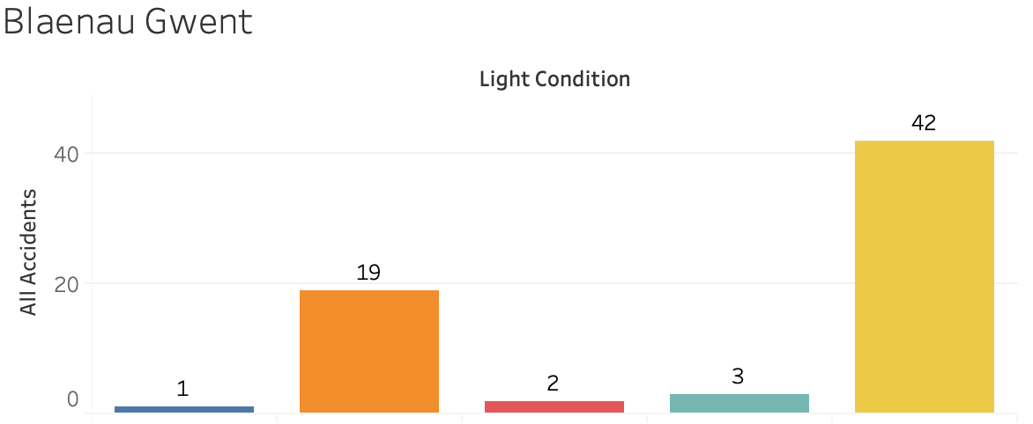
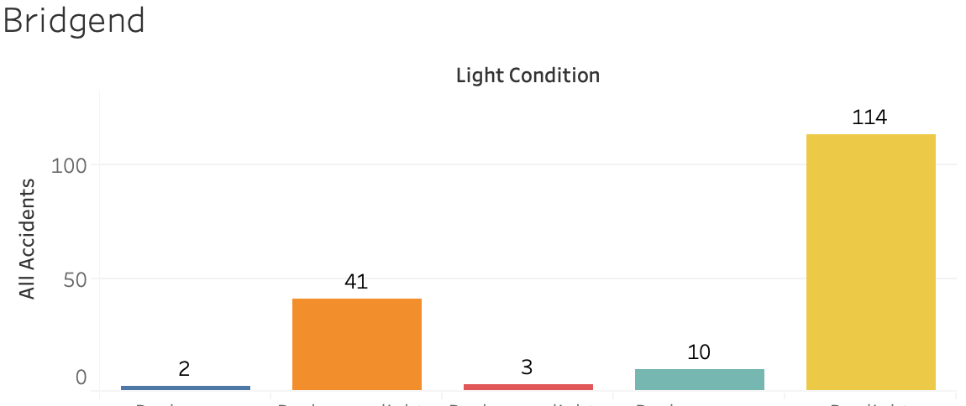
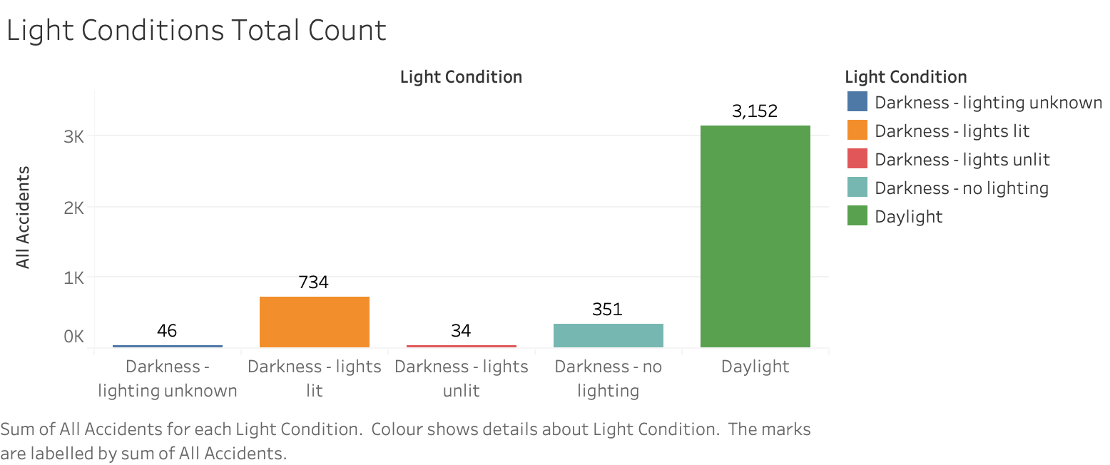
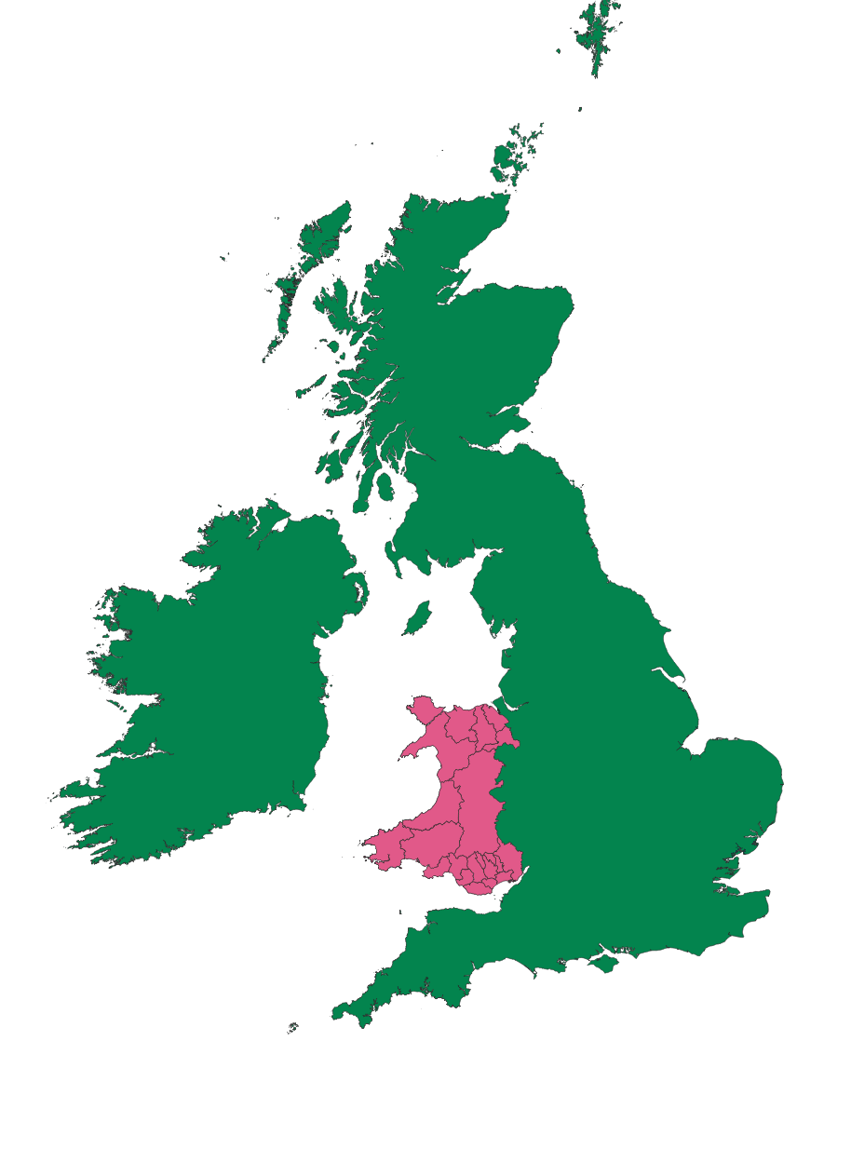
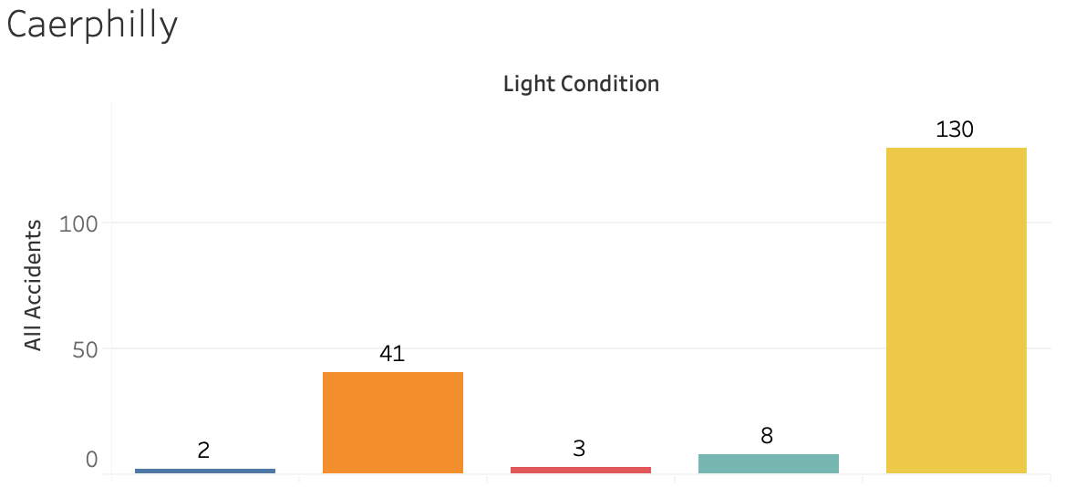
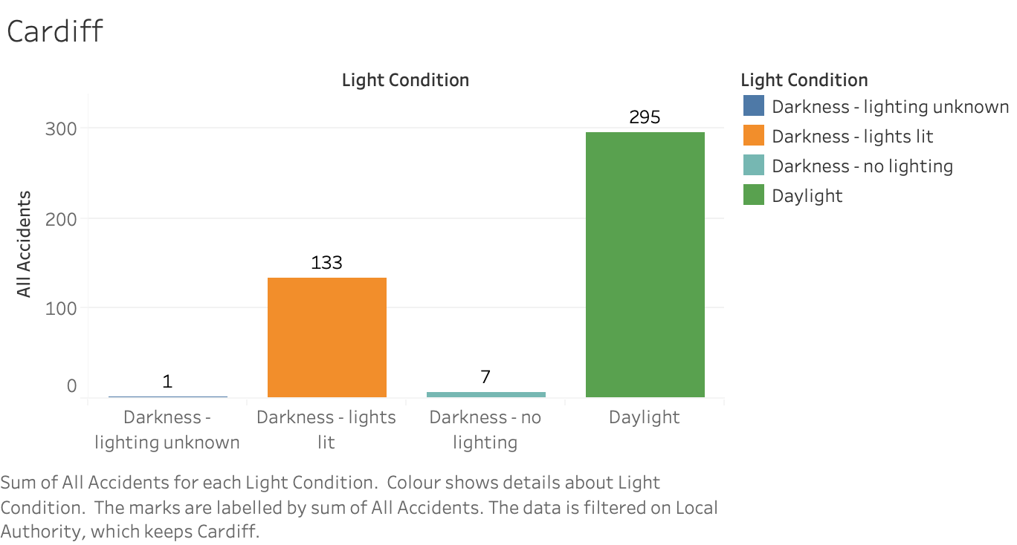
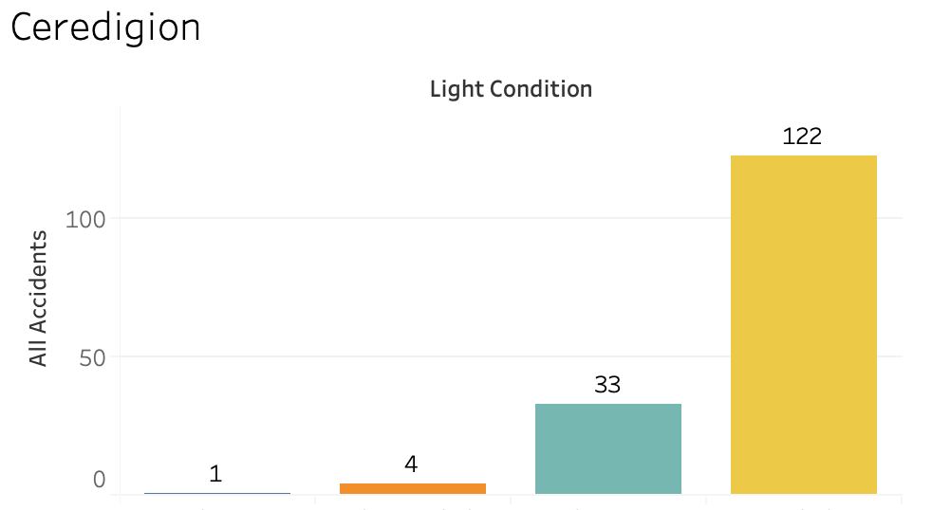
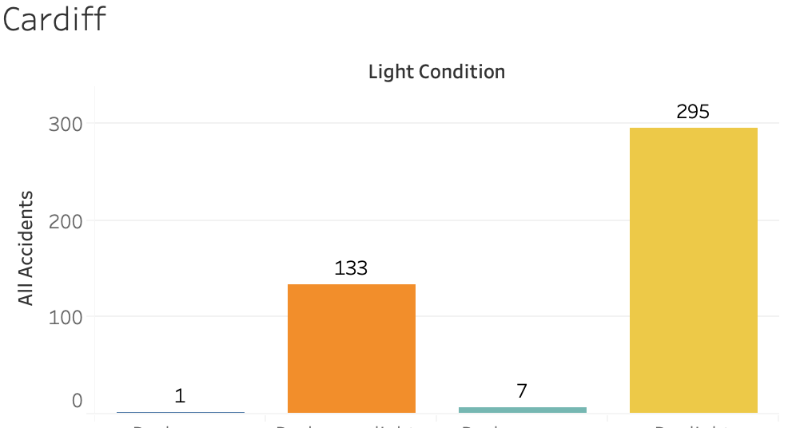
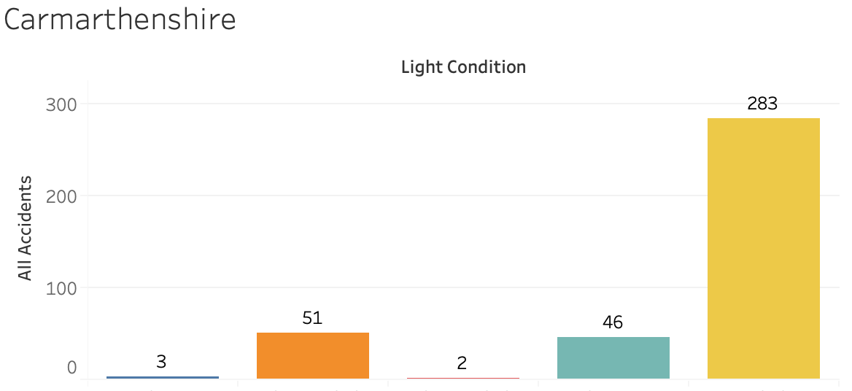
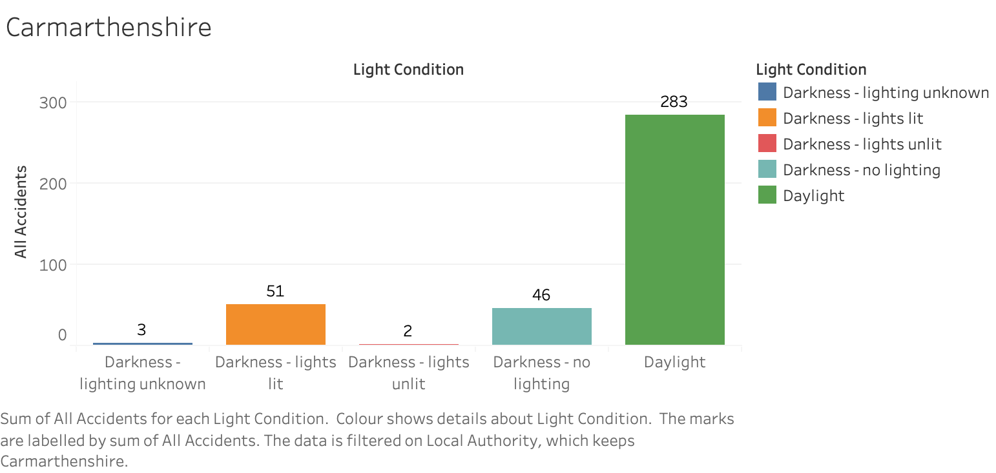
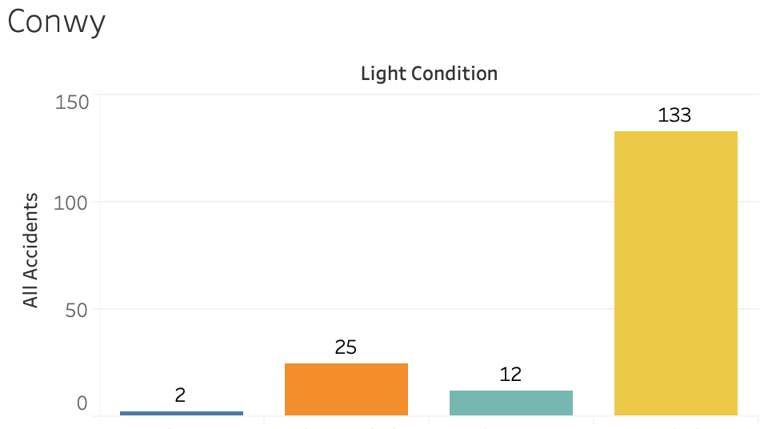
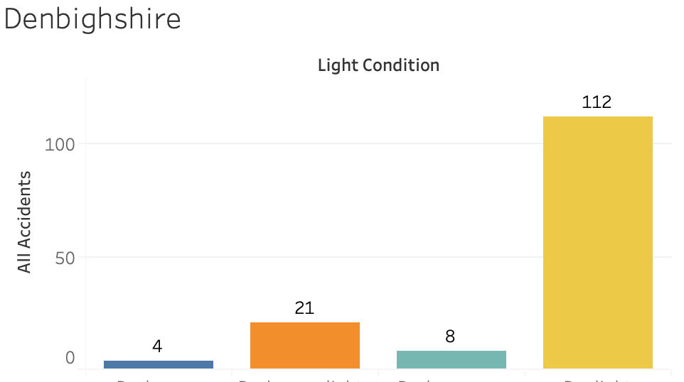
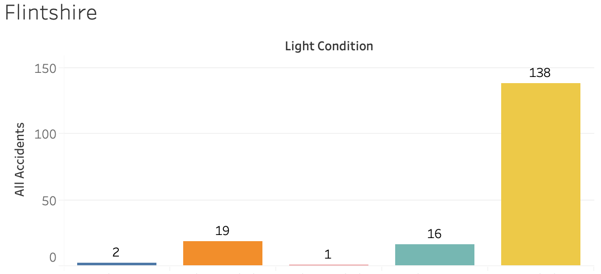
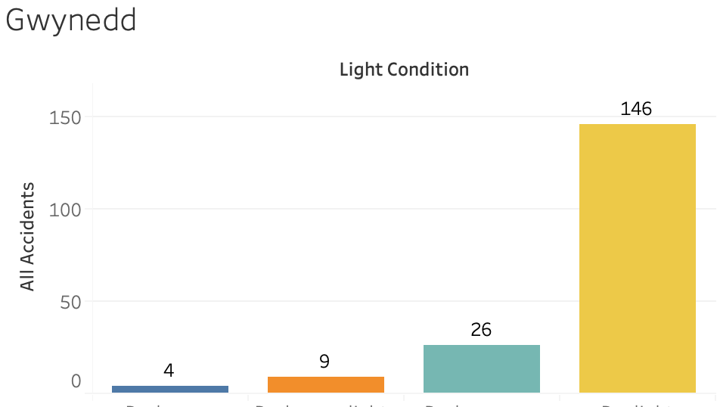
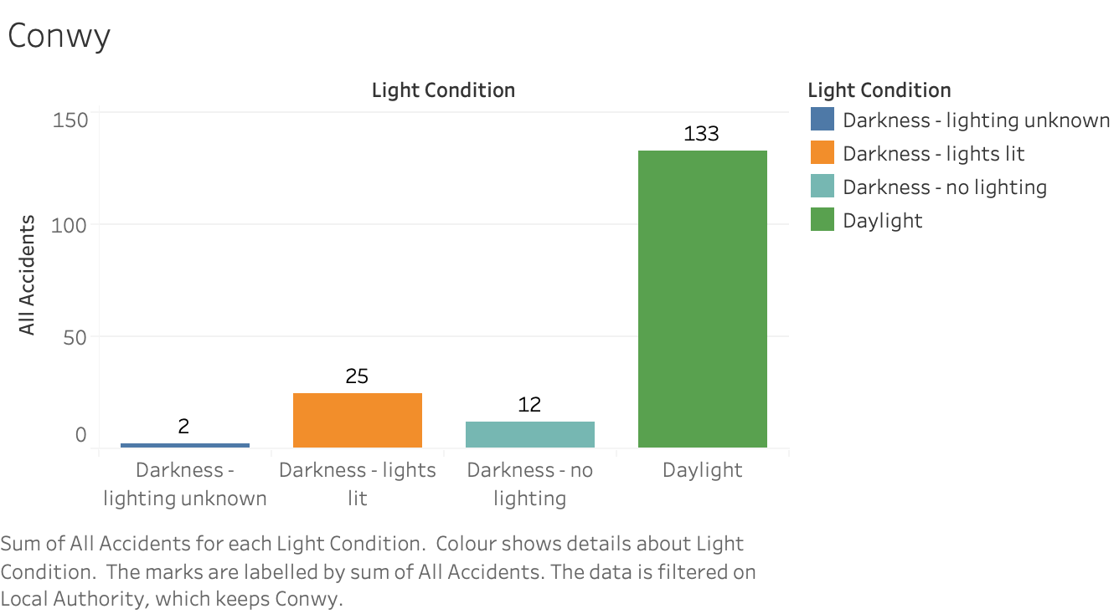
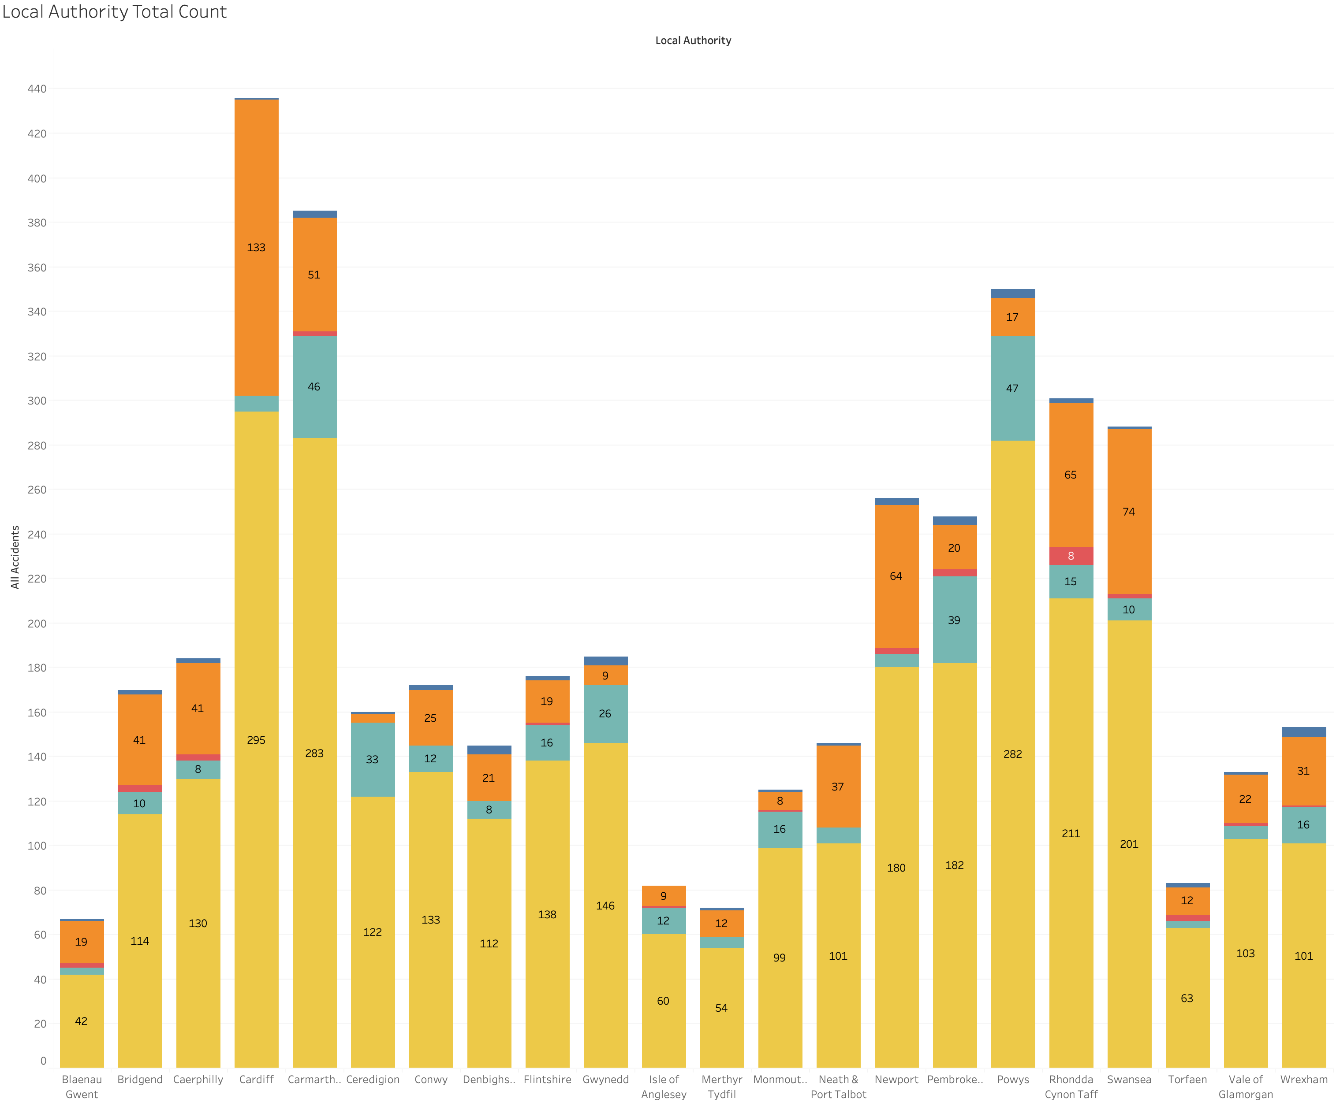
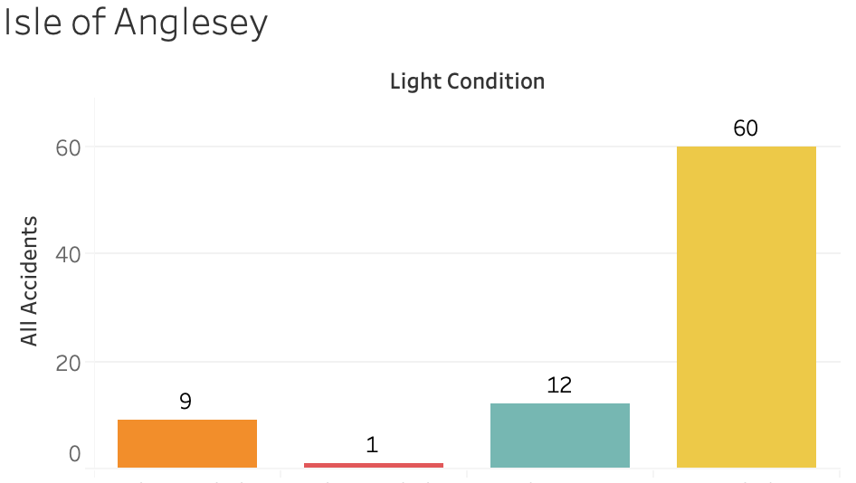
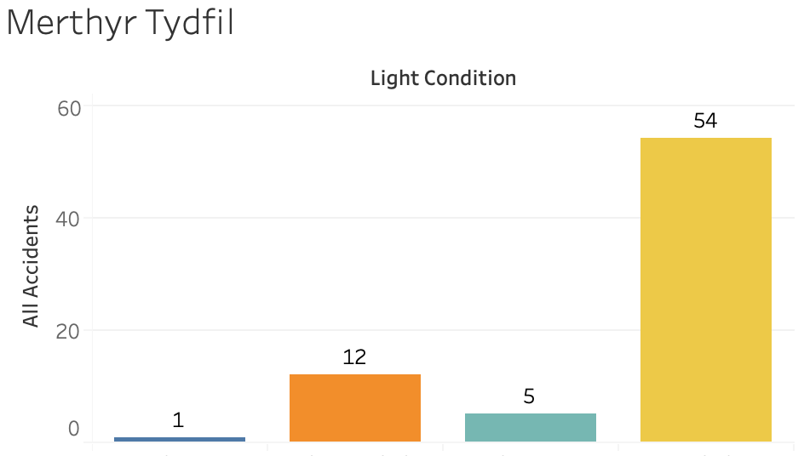
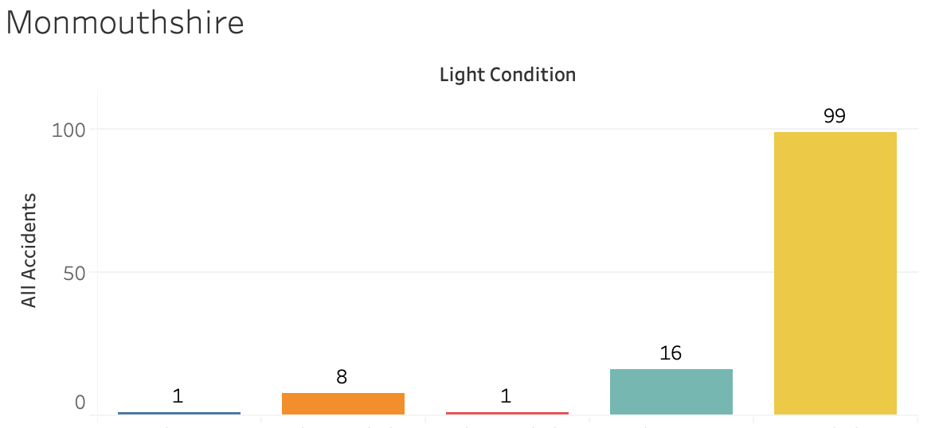
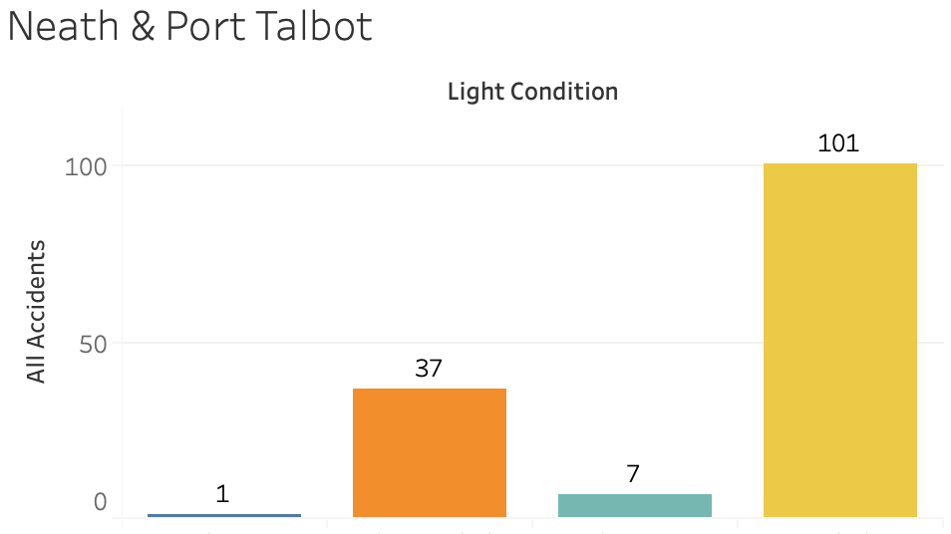
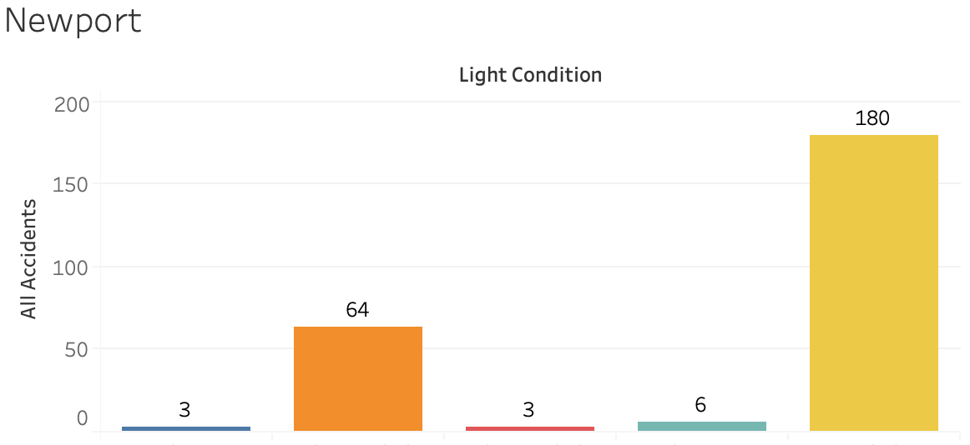
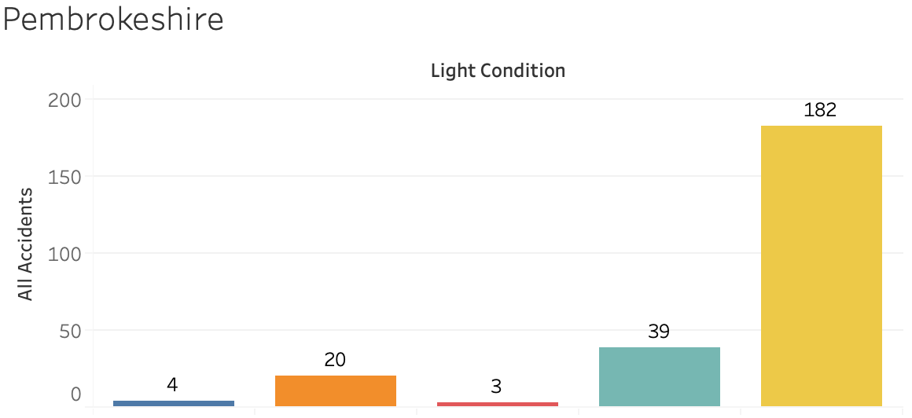
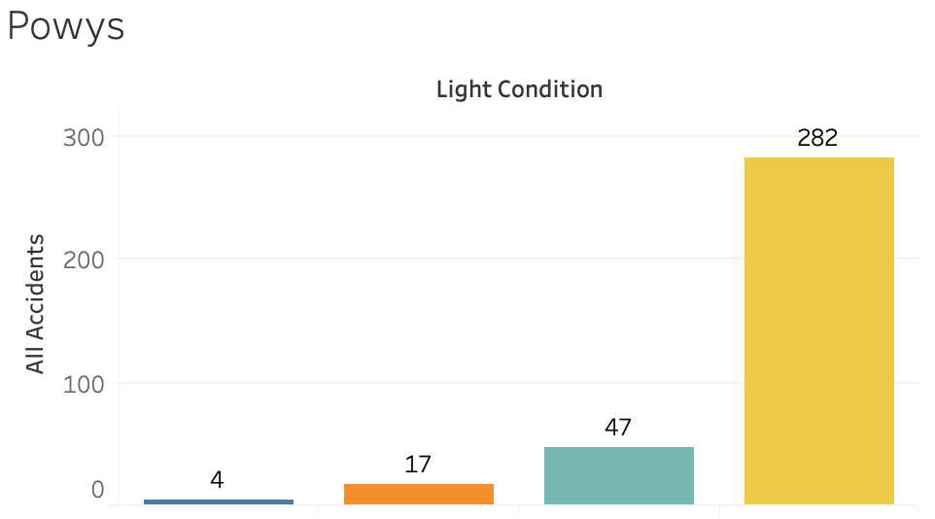
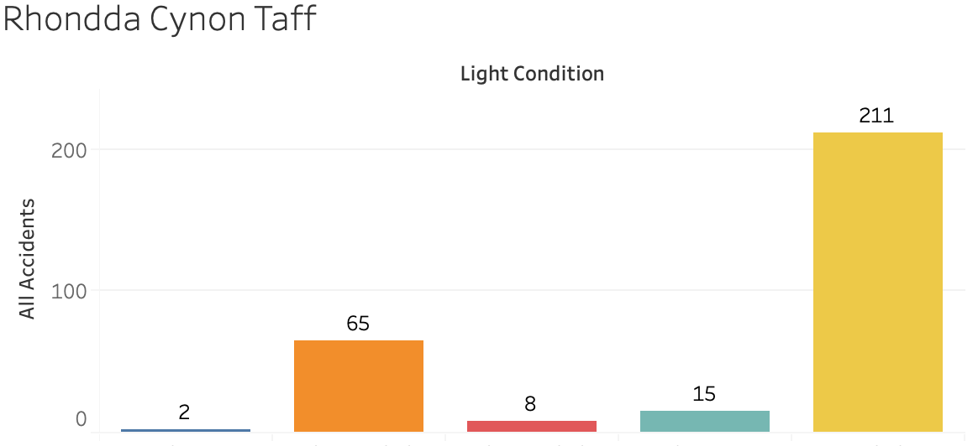
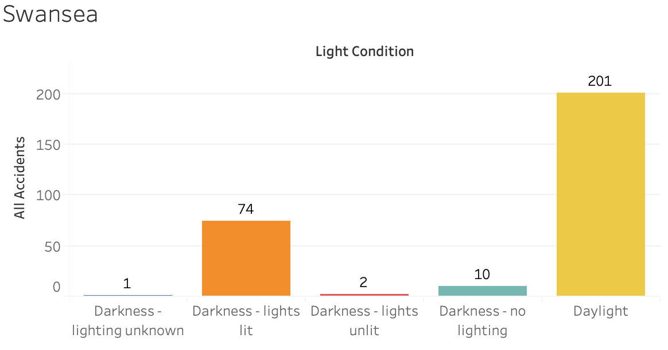
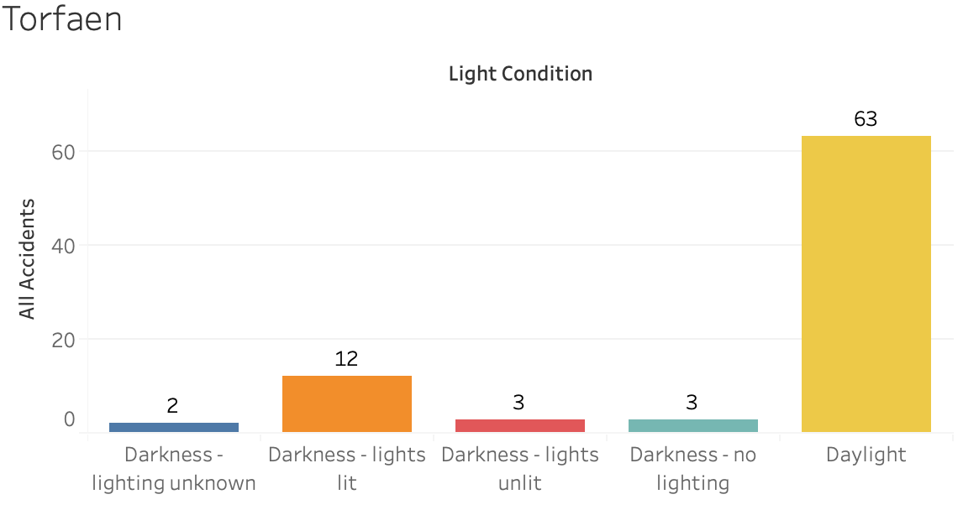
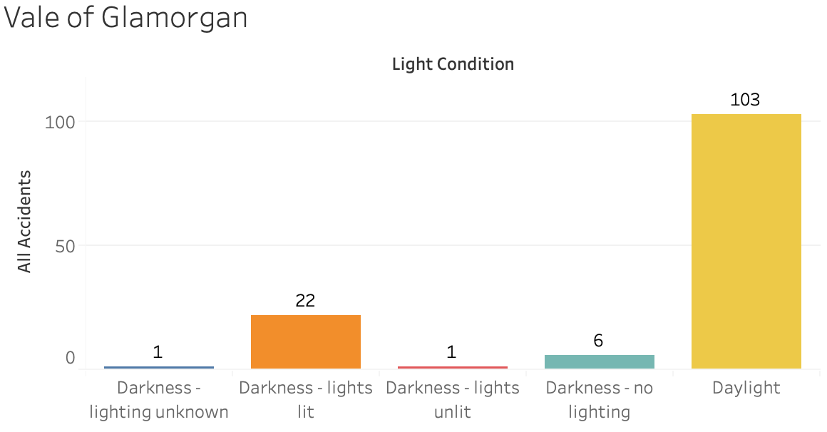
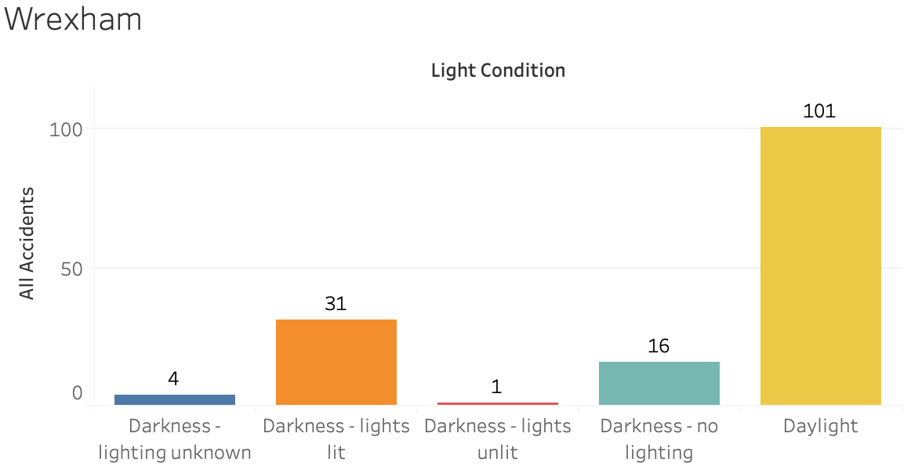
Total Crashes by Light Conditions in each Local Authority in Wales
Overview
The “Reported road accidents, Great Britain” dataset, is provided by the UK Government, licenced by Open Government Licence. The dataset contains road accidents in GB by severity, geography, year, local authority, road class and weather conditions in 2019. The different types of roads tracked are motorways, A, B, C and unclassified roads. A total of 4,317 observations. All observations get used while the light conditions and local authority categorised the data. The total sum of each accident got used.
Highest
Lowest
Notes:
9.5 cm
17.68 cm

Slide 2
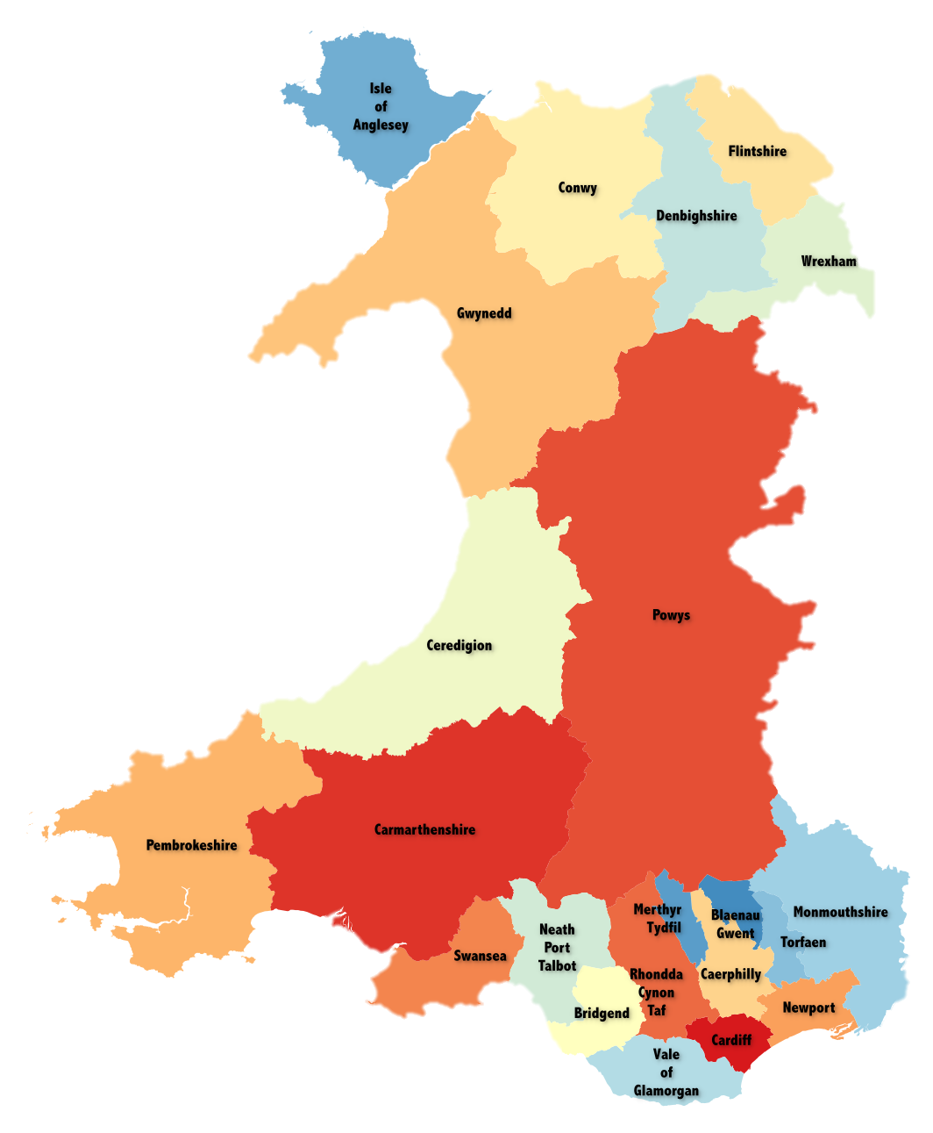
Total Crashes by Light Conditions in each Local Authority in Wales
Overview
The “Reported road accidents, Great Britain” dataset, is provided by the UK Government, licenced by Open Government Licence. The dataset contains road accidents in GB by severity, geography, year, local authority, road class and weather conditions in 2019. The different types of roads tracked are motorways, A, B, C and unclassified roads. A total of 4,317 observations. All observations get used while the light conditions and local authority categorised the data. The total sum of each accident got used.
Highest
Lowest
Notes:
9.5 cm
17.68 cm

Slide 3
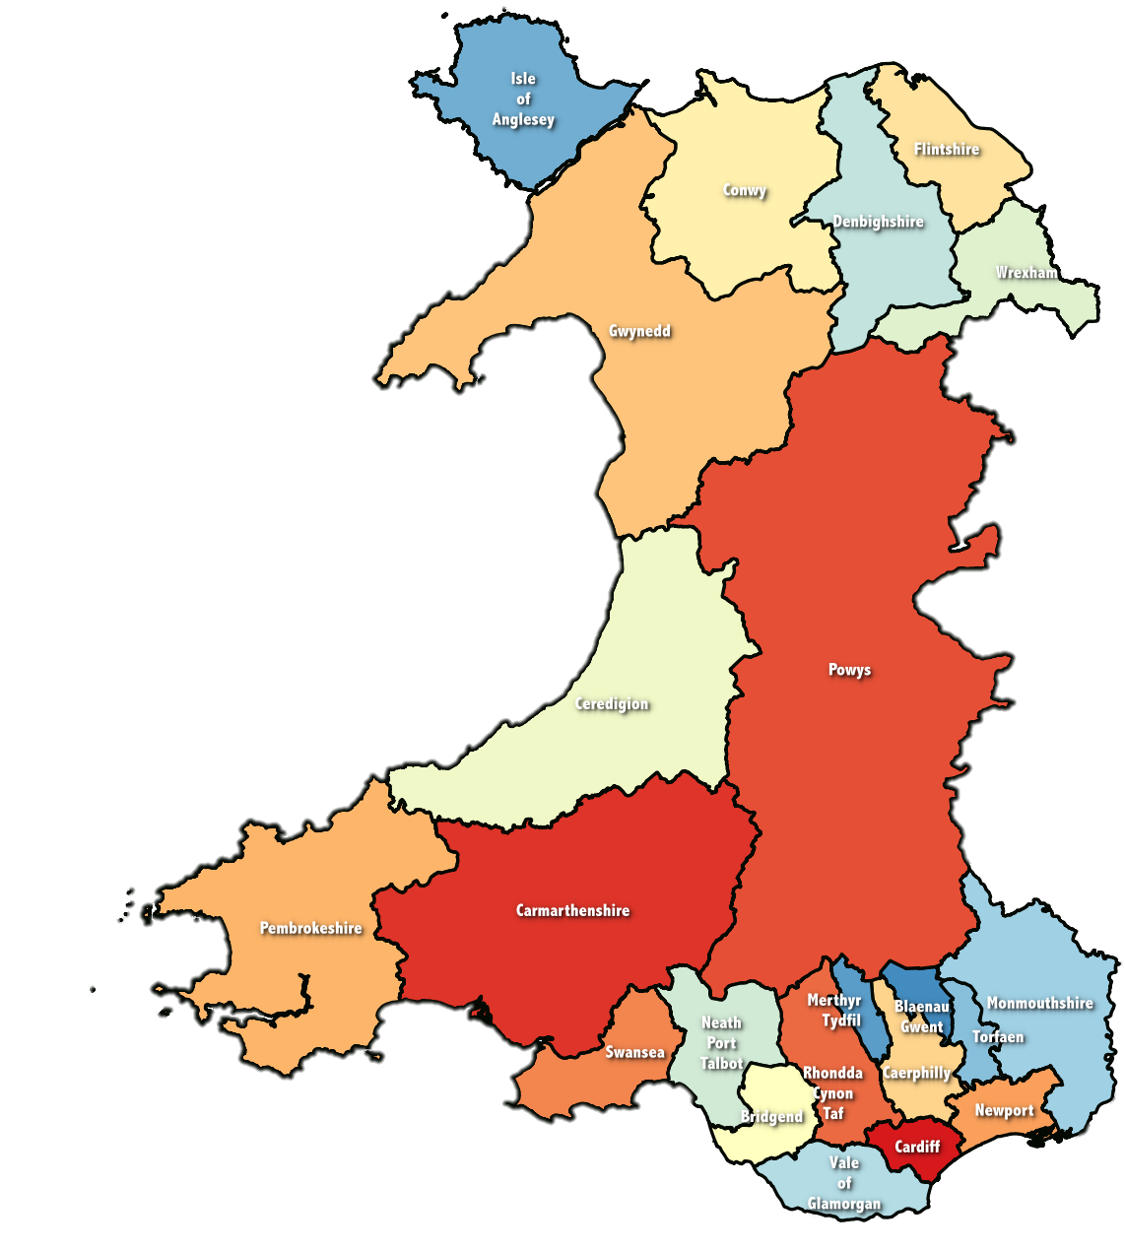
Total Crashes by Light Conditions in each Local Authority in Wales
Overview
The “Reported road accidents, Great Britain” dataset, is provided by the UK Government, licenced by Open Government Licence. The dataset contains road accidents in GB by severity, geography, year, local authority, road class and weather conditions in 2019. The different types of roads tracked are motorways, A, B, C and unclassified roads. A total of 4,317 observations. All observations get used while the light conditions and local authority categorised the data. The total sum of each accident got used.
Highest
Lowest
Notes:
9.5 cm
17.68 cm

